Slide 1

8th Grade Math: Pre-Algebra
Unit 9, Lesson 8 Dilations on the Coordinate Plane Volume 2, pg. 99

Slide 2


Benchmarks
MA.8.GR.2.2
Given a preimage and image generated by a single dilation, identify the scale factor that describes the relationship.
MA.8.GR.2.3
Describe and apply the effect of a single transformation on two-dimensional figures using coordinates and the coordinate plane.
volume 2, pg. 99

Slide 3
Integrated Mathematical Thinking and Reasoning Standards
MA.K12.MTR.1.1 Actively participate in effortful learning both individually and collectively.
MA.K12.MTR.2.1 Demonstrate understanding by representing problems in multiple ways.
MA.K12.MTR.4.1 Engage in discussions that reflect on the mathematical thinking of self and others.
MA.K12.MTR.5.1 Use patterns and structure to help understand and connect mathematical concepts.
volume 2, pg. 99

Slide 4

Learning Targets
I can describe how an image and preimage generated by a single dilation are related.
I can apply the effect of a dilation on the coordinate plane.
volume 2, pg. 99

Slide 5

Warm-Up
volume 2, pg. 100

Slide 6
9.8.1 Warm-Up: Which One Doesn’t Belong?
Four triangles are shown.
Which one doesn’t belong?
Explain your reasoning.
volume 2, pg. 100

Slide 7

Exploration
volume 2, pg. 100

Slide 8

9.8.2 Exploration: Dilations on the Coordinate Plane
On the coordinate plane, quadrilateral $DLHF$ was dilated with a scale factor of $\frac{1}{3}$ centered at the origin.
volume 2, pg. 100

Slide 9
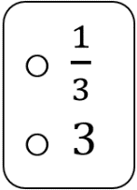
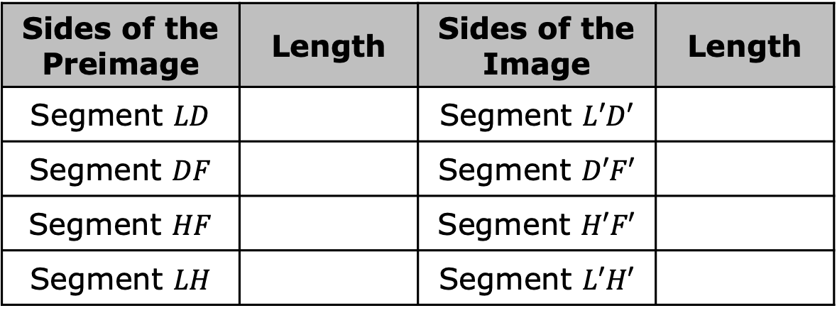

Complete the table.
Complete the statement.
The side lengths of quadrilateral $D^{′}L^{′}H^{′}F′$ are times the length of the
side of quadrilateral $DLHF$.
Sides of the Preimage | Length | Sides of the Image | Length
Segment $LD$ |  | Segment $L′D′$
Segment $DF$ |  | Segment $D′F′$
Segment $HF$ |  | Segment $H′F′$
Segment $LH$ |  | Segment $L′H′$
volume 2, pg. 100

Slide 10
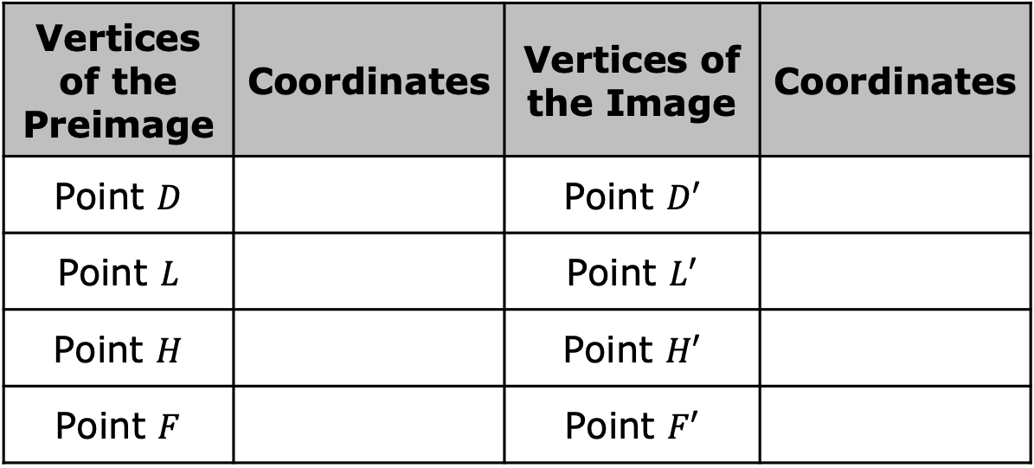
Complete the table with the coordinates of the vertices of the preimage and image.
What do you notice about the relationship between the coordinates of the corresponding points on the preimage and image?
Vertices of the Preimage | Coordinates | Vertices of the Image | Coordinates
Point $D$ |  | Point $D′$
Point $L$ |  | Point $L′$
Point $H$ |  | Point $H′$
Point $F$ |  | Point $F′$
volume 2, pg. 101

Slide 11
On the coordinate plane, $∆B′K′N′$ is the result of a dilation of $∆BKN$ centered at the origin. The scale factor is $1.5$.
volume 2, pg. 101

Slide 12
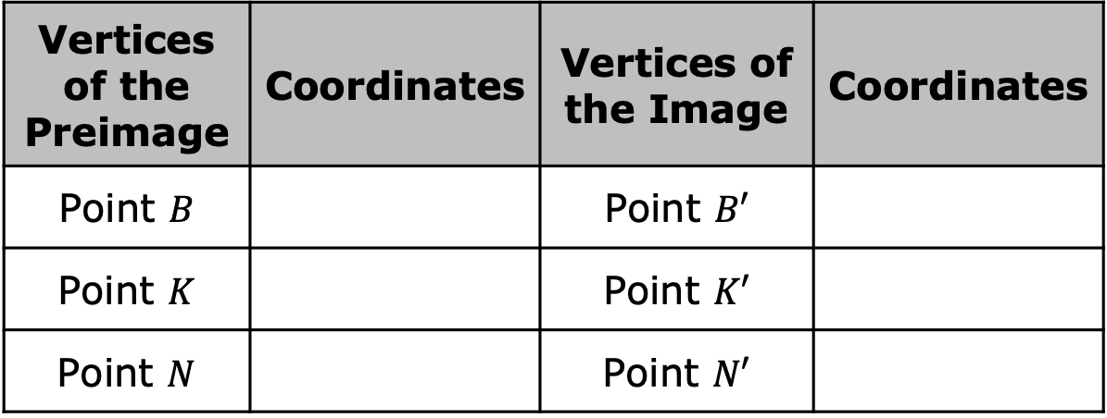
Complete the table with the coordinates of the vertices of the preimage and image.
Discuss with your partner how the relationship between the coordinates is related to the scale factor. Summarize your discussion.
Vertices of the Preimage | Coordinates | Vertices of the Image | Coordinates
Point $B$ |  | Point $B′$
Point $K$ |  | Point $K′$
Point $N$ |  | Point $N′$
volume 2, pg. 101

Slide 13

Suppose point $W$ is the vertex of a polygon and has coordinates $\left(2, 10\right)$.
If this polygon were dilated by a scale factor of $2.7$ centered at the origin, discuss with your partner how you could determine the coordinates of the image of point$W$.
Determine the coordinates of point $W’$.
volume 2, pg. 101

Slide 14

Bring It Together
volume 2, pg. 102

Slide 15


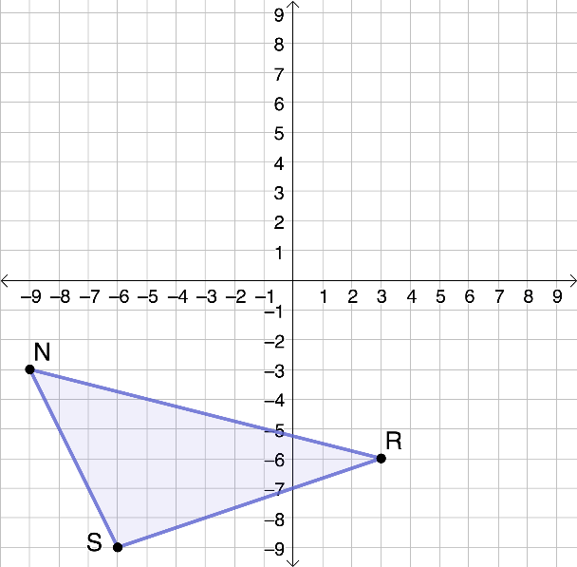
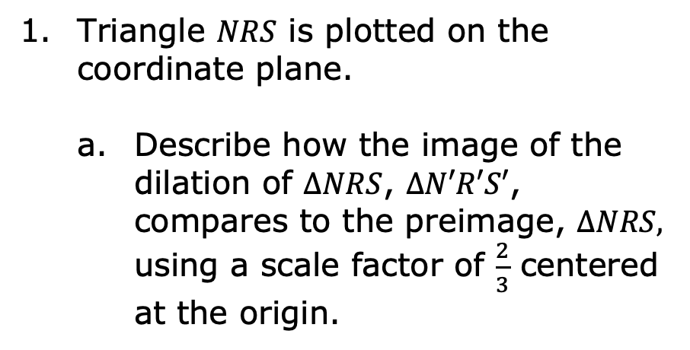
9.8.3 Bring It Together: Dilations on the Coordinate Plane
When a dilation is performed on a figure on the coordinate plane with its center at the origin, the coordinates of the image are equal to the coordinates of the preimage multiplied by the scale factor.
Triangle $NRS$ is plotted on the coordinate plane.
Describe how the image of the dilation of $∆NRS$, $∆N′R′S′$, compares to the preimage, $∆NRS,$ using a scale factor of $\frac{2}{3}$ centered at the origin.
volume 2, pg. 102

Slide 16
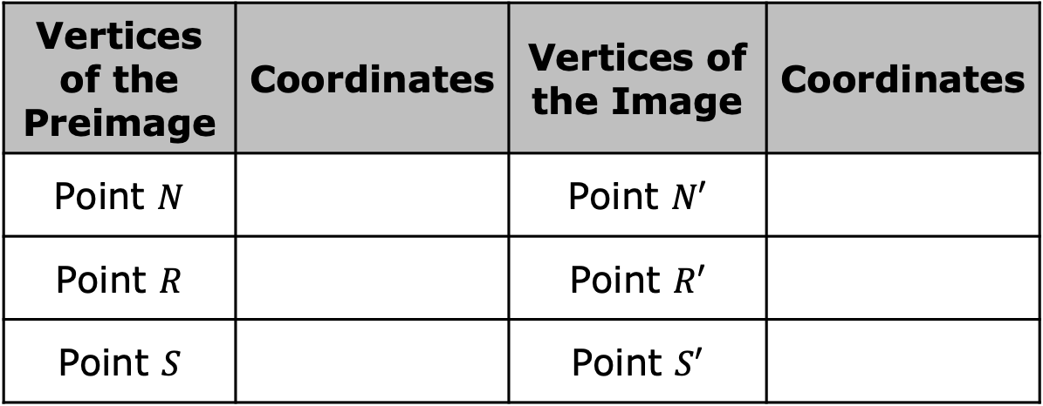

Complete the table.
Draw and label $∆N^{′}R^{′}S′$.
Vertices of the Preimage | Coordinates | Vertices of the Image | Coordinates
Point $N$ |  | Point $N′$
Point $R$ |  | Point $R′$
Point $S$ |  | Point $S′$
volume 2, pg. 102

Slide 17
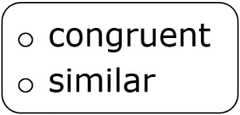
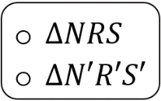
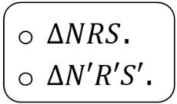
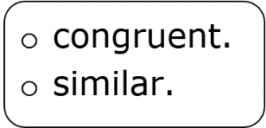
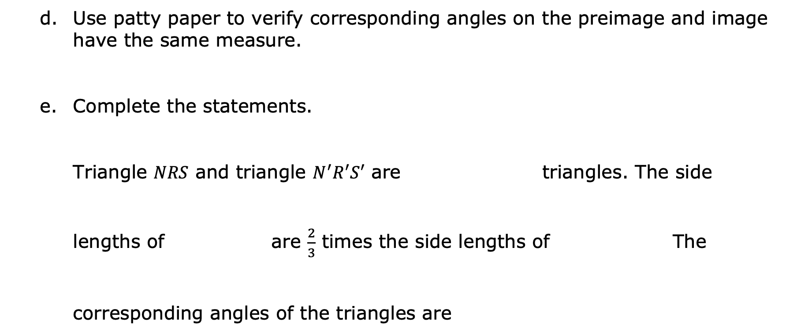
Use patty paper to verify corresponding angles on the preimage and image have the same measure.
Complete the statements.
Triangle $NRS$ and triangle $N^{′}R^{′}S′$ are triangles. The side
lengths of are $\frac{2}{3}$ times the side lengths of The
corresponding angles of the triangles are
volume 2, pg. 102

Slide 18

Guided Practice
volume 2, pg. 103

Slide 19

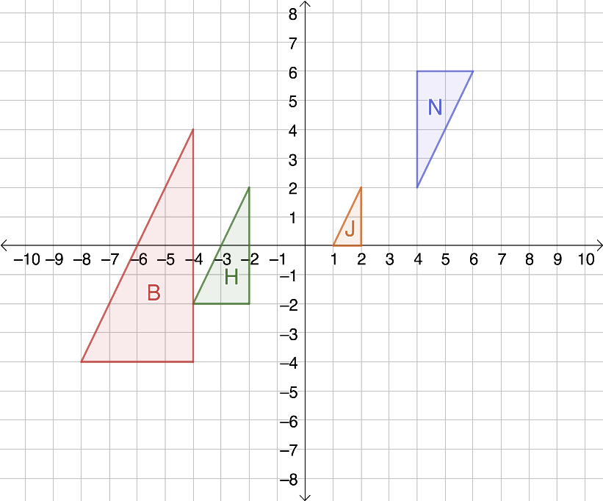
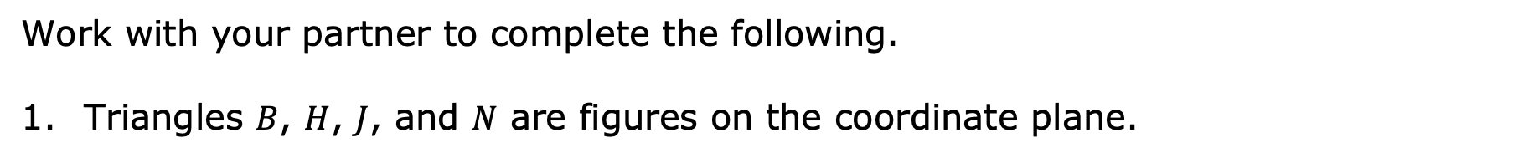
9.8.4 Guided Practice: Describe the Relationship
Work with your partner to complete the following.
Triangles $B$, $H$, $J$, and $N$ are figures on the coordinate plane.
volume 2, pg. 103

Slide 20
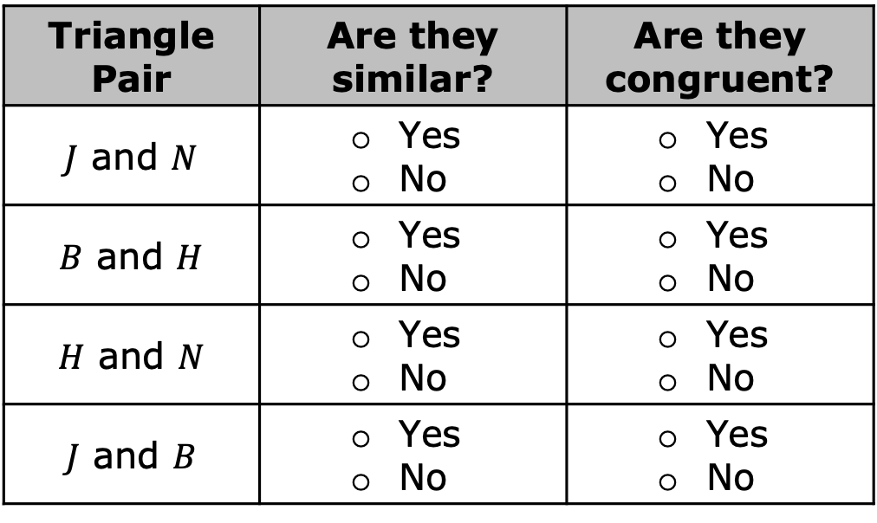

Discuss with your partner which triangles are similar or congruent. Then, complete the table.
Complete the statement.
Triangle ____ is the image of triangle ____ after a dilation using a scale factor of $\frac{1}{2}$ centered at the origin.
Triangle Pair | Are they similar? | Are they congruent?
$J$ and $N$ | Yes No | Yes No
$B$ and $H$ | Yes No | Yes No
$H$ and $N$ | Yes No | Yes No
$J$ and $B$ | Yes No | Yes No
volume 2, pg. 103

Slide 21
Explain how you determined your answer to Part B.
Work with your partner to describe at least three characteristics of the relationship between the triangles selected in Part B.
volume 2, pg. 103

Slide 22

Your Turn
volume 2, pg. 104

Slide 23
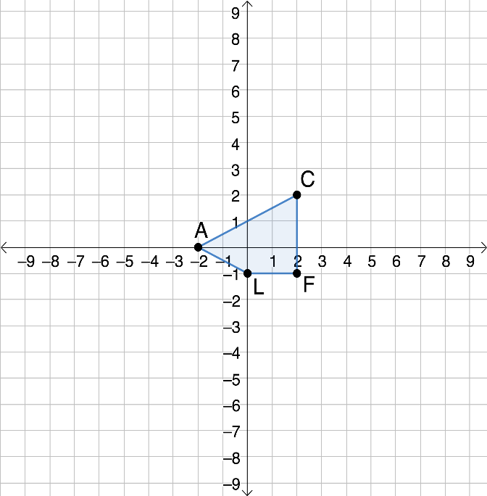
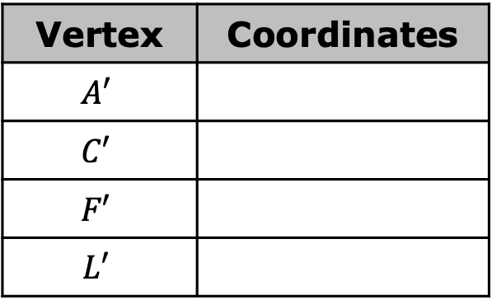
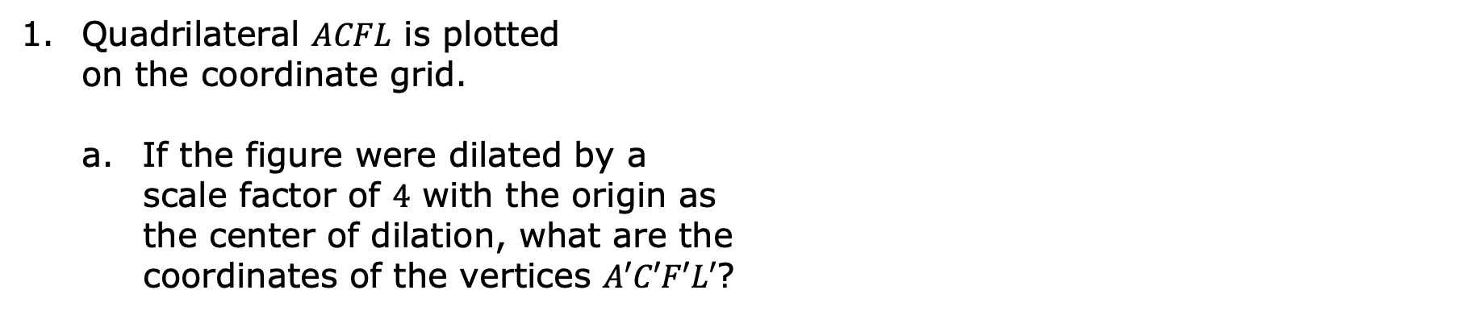
9.8.5 Your Turn!
Quadrilateral $ACFL$ is plotted on the coordinate grid.
If the figure were dilated by a
scale factor of $4$ with the origin as the center of dilation, what are the coordinates of the vertices $A′C′F′L′$?
Vertex | Coordinates
$$A′$$
$$C′$$
$$F′$$
$$L′$$
volume 2, pg. 104

Slide 24
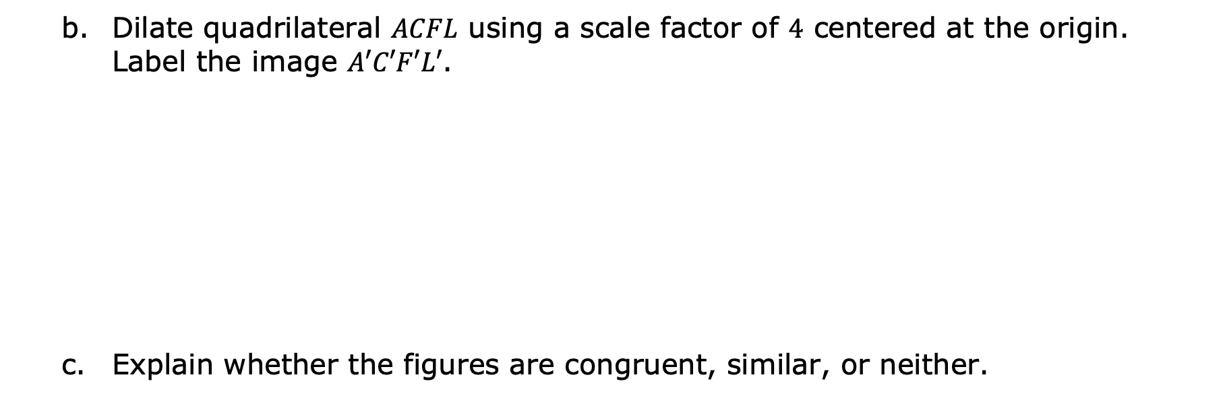
Dilate quadrilateral $ACFL$ using a scale factor of $4$ centered at the origin. Label the image $A′C′F′L′$.
Explain whether the figures are congruent, similar, or neither.
volume 2, pg. 104

Slide 25

Wrap-Up
volume 2, pg. 105

Slide 26
9.8.6 Wrap-Up: Growth Mindset
Complete each statement based on today’s lesson.
Today I am still unsure about …
I will try to build my confidence by …
volume 2, pg. 105

